Slide 1
ALLIED RESPONSE
Rome falls to allies- June 4 1944
Italians overthrew Mussolini- executed April 28, 1945
World leaders:
April 12, 1945 FDR dies
Battle of the Bulge-Dec., 1945 Hiter’s last stand Hitler commits suicide April 30, 1945

Slide 2
D-Day
June 6, 1944 (Operation Overlord)- 176,000 troops sent from English channel to beaches of Normandy
By August 25th the allies took back Paris and could now attack Germany
The end is coming- V-E day May 7, 1945

Slide 3
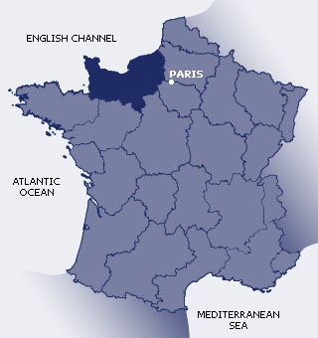
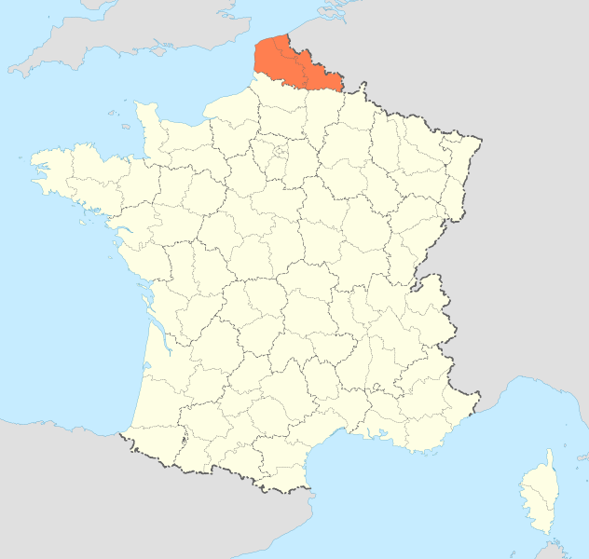
Fake invasion Calais v. Normandy

Slide 4
Some serious deception
Operation bodyguard- a fake operation designed to convince Germany that allies would attack at Calais
Operation fortitude- operation of attack to Norway even went as far as having dummy tanks
“Double agents”- allies turned agents working for Germany in Britain

